Slide 1



CAPSTONE PROJECT
AI adoption and usage analysis
Presented By
Student Name: Akshita rathour
College Name: Bareilly college
Department: computer science
Email ID: AKSHITARATHOUR2@gmail.com

Slide 2
OUTLINE:
Problem Statement
Proposed System/Solution
System Development Approach (Technology Used)
Algorithm & Deployment
Result (Output Image)
Conclusion
Future Scope
References

Slide 3
Problem Statement:
Artificial intelligence is rapidly being adopted across industries . However , organizations often struggle to understand how AI adoption varies across countries, industries , and company sizes.
Without proper analysis , it becomes difficult to identify trends in AI tool usage and user engagement.
Therefore, there is a need to analyze AI adoption data to understand patterns and provide meaningful insights .

Slide 4
Proposed Solution:
The proposed system analyses AI adoption trends using data visualization techniques.
The system focuses on :
Collecting AI adoption dataset
Cleaning and preparing the dataset
Analyzing patterns in AI tool usage
Creating an interactive dashboard for insights
These dashboard helps user understand:
AI adoption rate across industries
Most widely used AI tools
User distribution across countries and age groups

Slide 5
System Approach:
The system was developed using the following technologies:
Power BI for dashboard creation and data visualization
Power query for data cleaning and transformation
Dataset containing AI adoption information across industries
The development process include data preparation, analysis , and visualization.

Slide 6
Algorithm & Deployment:
This project primarily uses data analytics and visualization data techniques . The process includes:.
Data Input:
Country, industry, AI tool, adoption rate, Daily active users, age group, company sizes
Analysis Process:
Data cleaning using power query.
Aggregation of data for insights.
Visualization using charts and graphs.
Deployement:
The dashboard was developed in power BI and provide interactive insights through filters and charts.

Slide 7
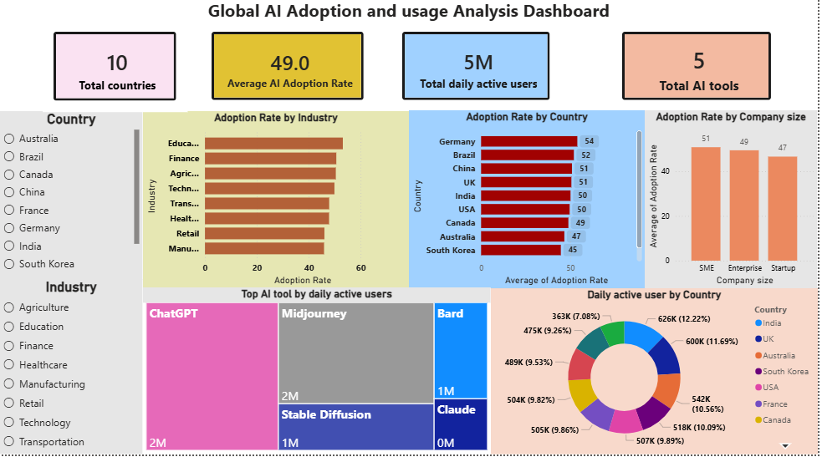
Result:
Key insights:
Average AI adoption rate across industries is 49%.
Total daily active users are around 5M.
Chatgpt is the most used AI tool.
SME shows higher adoption ratet than large companies.
Germany has one of the highest adoption rate
Education sector shows high AI adoption

Slide 8
Conclusion:
The project successfully analyses AI adoption trends using data visualization techniques.
The dashboard provides insights into how AI tools are used across industries and countries.
Such analysis helps organization understand technology trend and make better strategic decisions.

Slide 9
Future scope:
Future improvements for this project includes:
Adding more real-world datasets
Using machine learning models to predict AI adoption trends
Expanding the analysis to more industries and regions.

Slide 10
References:
AI adoption datasets from online sources
Microsoft power BI documentation
Data visualization tutorials
MS Elevate AICTE internship orientation session
GitHub Link: Link

Slide 11
Thank You

